Slide 1
UNDER WATER IMAGE ENHANCEMENT AND RESTORATION USING AI & ML
Presented By : Aparna Padmakumar
Amrutha Padmakumar
Tejaswini Rasal
Hitesh Khandelwal
B.E. (Information Technology)
PIN: ARMIET/IT 19 AP 02
ARMIET/IT 19 AP 01
ARMIET/IT 19 TR 04
ARMIET/IT 18 KH 10
SEMESTER –VII
Guided By: Dr. Santosh Kumar Dwivedi

Slide 2
CONTENTS
Abstract
Aim
Introduction
Scope of Work
Problem statement
Problem solution
Existing system
Advantages
System architecture
Hardware and software requirements
Module description
Conclusion
References

Slide 3
ABSTRACT
In this project, we are developing a Under Water Image Enhancement and Restoration. The main objective of the Project is to reduce the noises in the Underwater Images. We propose some methods for efficient removal of Noises using Image Processing Techniques. The Underwater images have low quality which makes it a difficult process to analyze the images. Here we propose Image Enhancement and Image Restoration process for increasing the quality of Underwater Images. CLAHE, Rayleigh distribution, DCP and MIP, RGHS, ULAP methods are used in this project.

Slide 4
AIM
Our main aim is to develop a Under Water Image Enhancement and Restoration with reef Classification which will help to reduce the noises in the Underwater Images and ensures clarity to the images.

Slide 5
INTRODUCTION
Underwater images often have severe quality degradation and distortion due to light absorption and scattering in the water medium. A hazed image formation model is widely used to restore the image quality. It depends on two optical parameters: the background light (BL) and the transmission map (TM). Underwater images can also be enhanced by color and contrast correction from the perspective of image processing. In this paper, we propose an effective underwater image enhancement method for underwater images in composition of underwater image restoration and color correction.

Slide 6
SCOPE OF WORK
This project is still in its initial stages and needs more future work to be perfect. The future work that will be accomplished will consist of:
Enhancing the testing methods
The desired image enhancement method should be able to adapt to various underwater conditions and develop an applicable enhancement strategy for different kinds of underwater applications.
Launching a public application

Slide 7
EXISTING SYSTEM
Underwater image enhancement often apply outdoor image enhancement methods directly to underwater images.
Now methods are specially designed according to the characteristics of the underwater image, e.g., hazing, color cast, and low contrast. These methods change the pixels values in either the spatial domain or a transformed domain.

Slide 8
ADVANTAGE
Enhancement of underwater images is essential for inspection of underwater infrastructure and detection of many man-made objects.
The need for enhancement is also to understand marine biology, and for environmental evaluation.
It also finds application in the research of monuments submerged in water.
Enhancements are used to make it easier for visual interpretation and understanding of imagery. The advantage of digital imagery is that it allows us to manipulate the digital pixel values in an image.

Slide 9
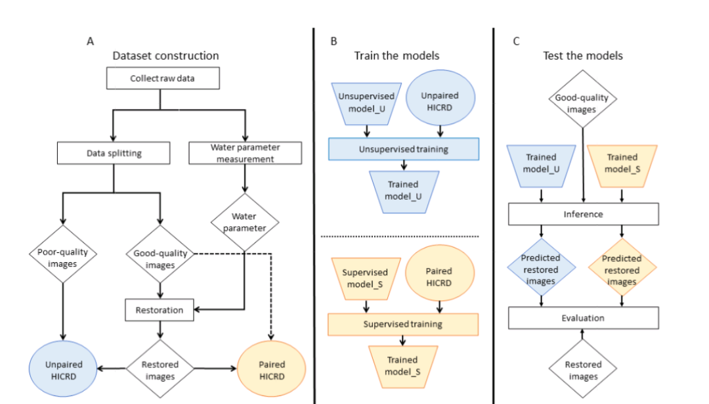
SYSTEM ARCHITECTURE

Slide 10
HARDWARE REQUIREMENTS
Processor : i3
RAM : 8GB
Hard Disk : 10GB
Input devices :Standard Keyboard and Mouse
Output devices : High Resolution Monitor

Slide 11
SOFTWARE REQUIREMENT
Operating System : windows 10
Language : Python , HTML
Technology used: AI, ML

Slide 12
DATASETS
Following are the datasets used:
HICRD
Pocillopora
Acropora
Turf

Slide 13
TECHNIQUES USED
IMAGE ENHANCEMENT
CLAHE - CONTRAST LIMITED ADAPTIVE HISTOGRAM EQUALIZATION
RAYLEIGH DISTRIBUTION
RGHS - RELATIVE GLOBAL HISTOGRAM STRECHING
IMAGE RESTORATION
DCP - DARK CHANNEL PRIOR
MIP - MAXIMUM INTENSITY PROJECTION
ULAP - UNDERWATER LIGHT ATTENUATION PRIOR

Slide 14
MODULE DESCRIPTION
The four steps for building a machine learning model are:
1. Select and prepare a training data set necessary to solving the problem. This data can be labeled or unlabeled.
2. Choose an algorithm to run on the training data.
If the data is labeled, the algorithm could be regression, decision trees, or instance-based.
If the data is unlabeled, the algorithm could be a clustering algorithm, an association algorithm, or a neural network.
3. Train the algorithm to create the model.
4. Use and improve the model.

Slide 15
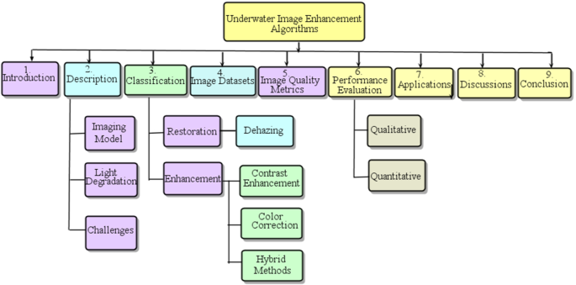
FLOWCHART
.

Slide 16
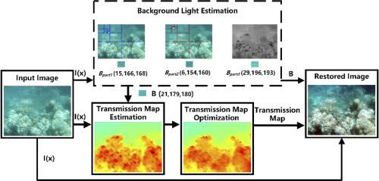
OUTPUT

Slide 17
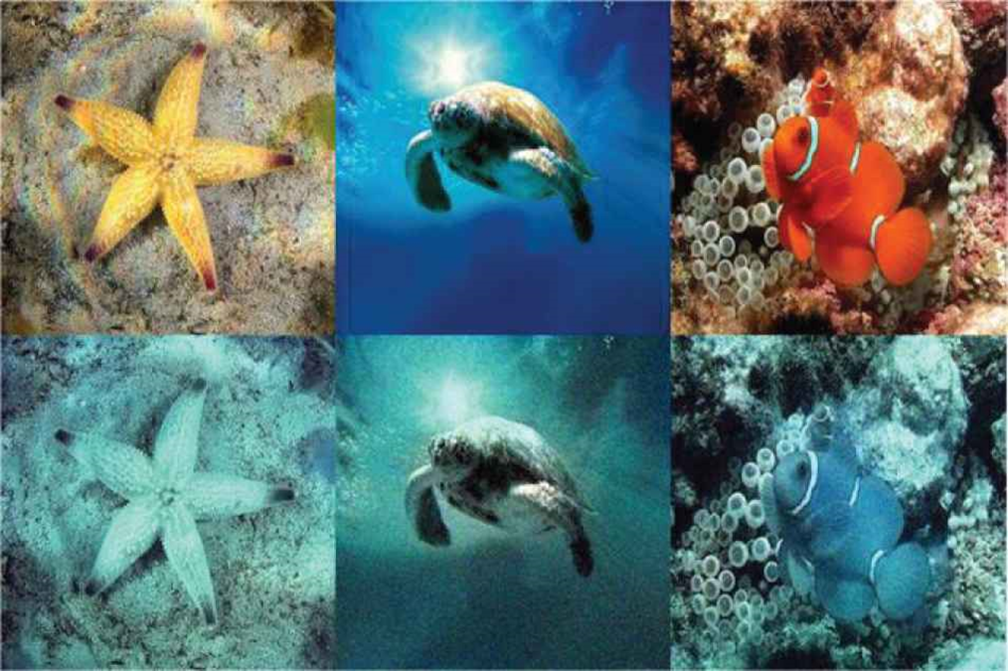
OUTPUT

Slide 18
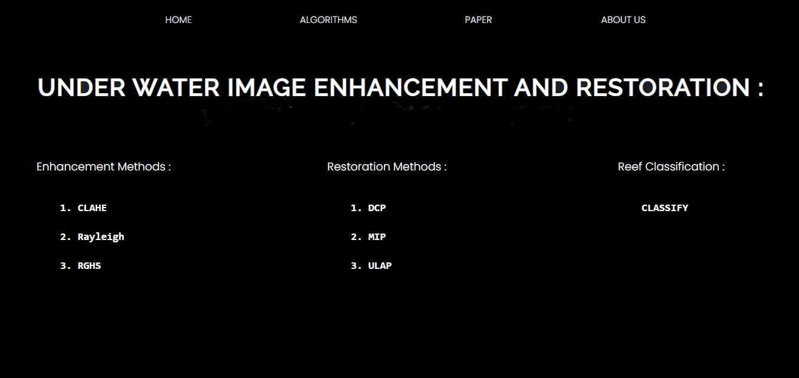
OUTPUT

Slide 19
CONCLUSION
We proposed an enhancement method for underwater images with uniform or non-uniform illumination conditions. In practical operations, these conditions usually correspond to the shallow-water environment and the deep-sea environment, respectively. The proposed method is composed of two modules: color-tone correction and fusion-based descattering. The first module reduces the regional or full-extent color-tone deviation that is caused by different types of incident light. And the second module solves the problems of low contrast and pixel-wise color deviation that are left after applying the first module.

Slide 20
REFERENCE
[1] C. S. Tan, G. Seet, A. Sluzek A, et al., “A novel application of range-gated underwater laser imaging system (ULIS) in near-target turbid medium,” Optics and Lasers in Engineering, vol. 43, no. 9, pp. 995-1009, 2005.
[2] Y. W. Huang, F. M. Cao, W. Q. Jin, et al., “Underwater pulsed laser range-gated imaging model and its effect on image degradation and restoration,” Optical Engineering, vol. 53, no. 6, pp. 061608, 2006.
[3] F. R. Dalgleish, F. M. Caimi, W. B. Britton, et al., “An AUV-deployable pulsed laser line scan (PLLS) imaging sensor,” Oceans. IEEE, pp. 1-5, 2007.
[4] Z. P. Xu, H. H. Shen, Y. Yao, et al., “Direct ranging scanning laser active imaging verification system,” Optical precision engineering, vol. 24, no. 2, pp. 251-259, 2009.
[5] K. Ingrid, “Underwater Imaging and the effect of inherent optical properties on image quality,” Master thesis, Norwegian University of Science and Technology, 2012.

Slide 21
THANK YOU

